Slide 1



PRESENTATION
Taking Notes
Second brain methode
“ Or how a memory lost make me change my technical watch ! “
Antoine Monnier

Slide 2


INTRODUCTION
The Anecdote
6 month ago
Custom Linux ISO image
“Ah, but how did I do that in my previous job ?”

Slide 3

ISSUE
How to find back Information
Knowledge seen and documented in a previous job
I know I have seen it
Hard to find
Lost information

Slide 4
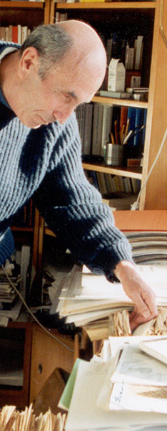

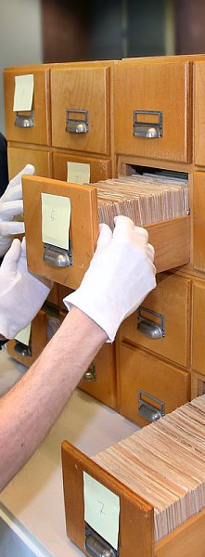
DISCOVERY
Zettlekasten
*
Atomic Note
Reference Note to Note
Notes Indexes
Niklas Luhmann => 90 000 notes
* Notes box

Slide 5
DISCOVERY
Exploration Compass
Theme / Question
N
Atomic Note
Zettlekasten
Similar
W
E


Opposit
S
Lead to


Slide 6




DISCOVERY
Zettlekasten
Types of notes
Compile
Refer
Refer
FLEETING
On the fly
LECTURE
Sources
To read later
PERMANENT
Knowledge
Reappropriated

Slide 7





SEARCH
Need
Simple
– Quick Add
– Easy Navigate
Organization
– Full search
– Handle Fleeting/Lecture/Permanent
Synchronise
PC Perso –
PC Pro –
Smartphone –
Zettlekasten
Note taking Application Second brain
Template
Formalize Zettlekasten –
Standardize Note –
Customization
– Appearance
– Features

Slide 8
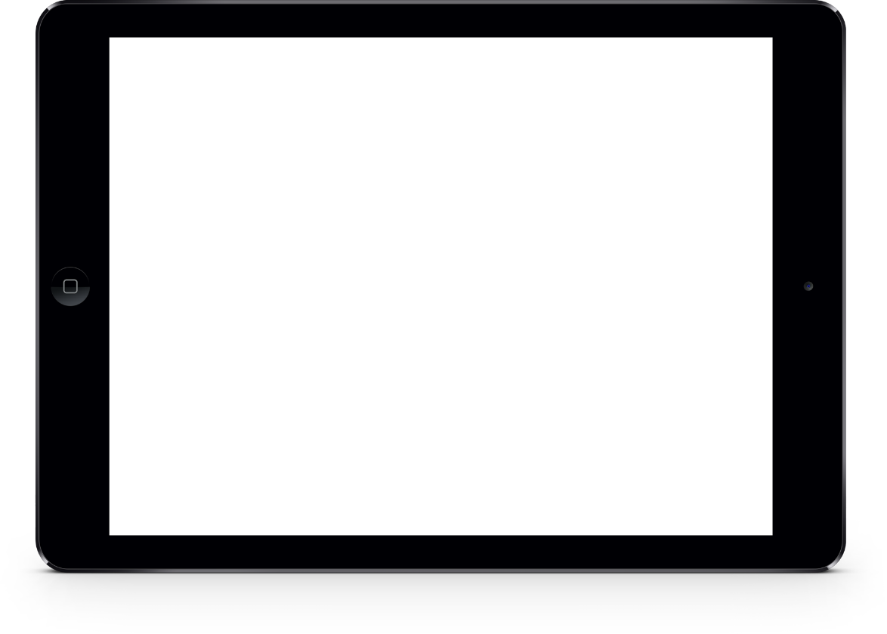
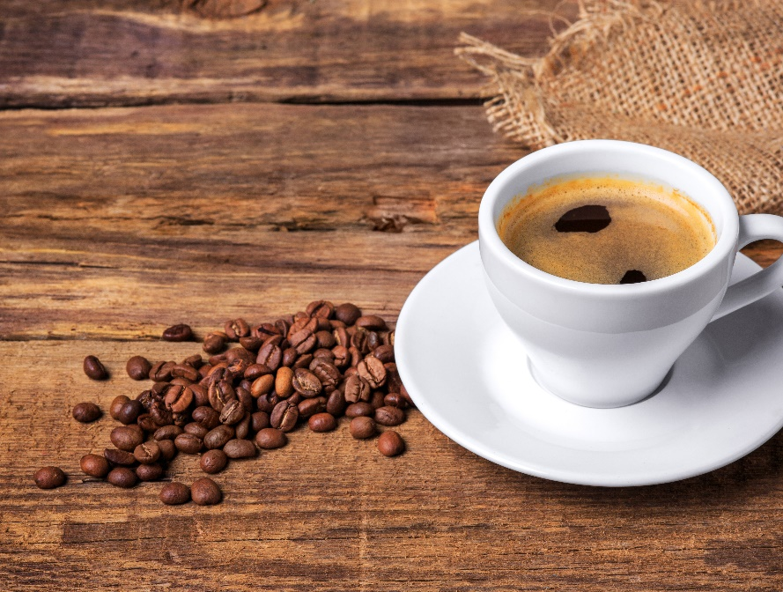
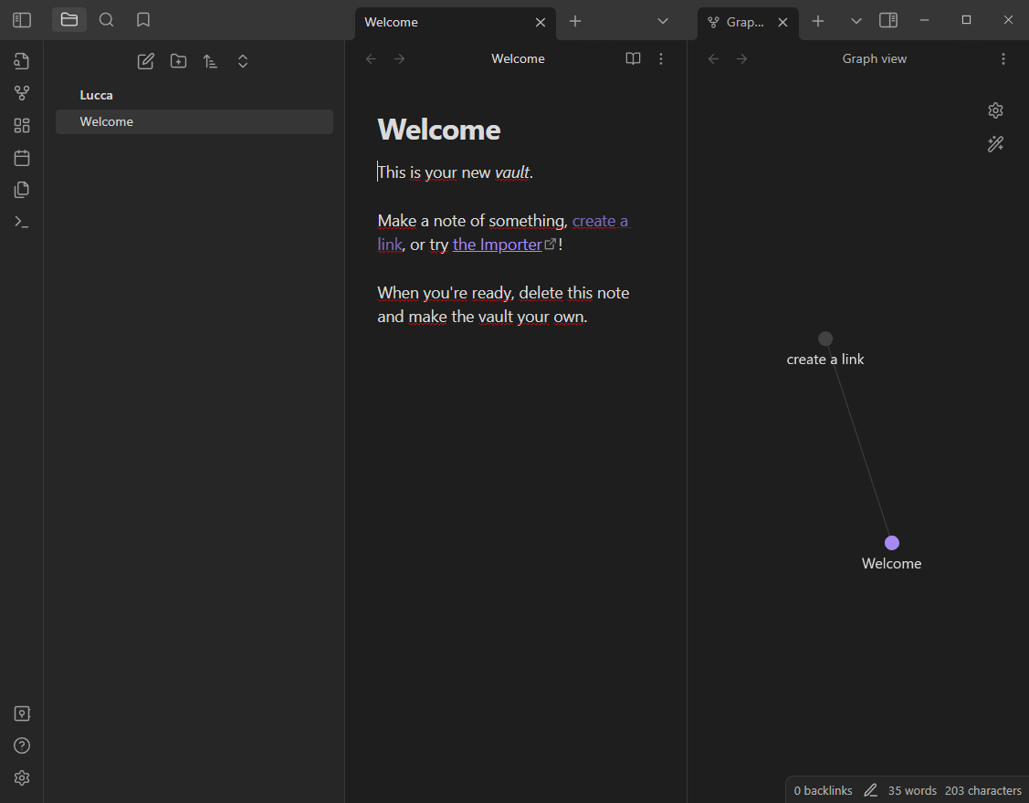

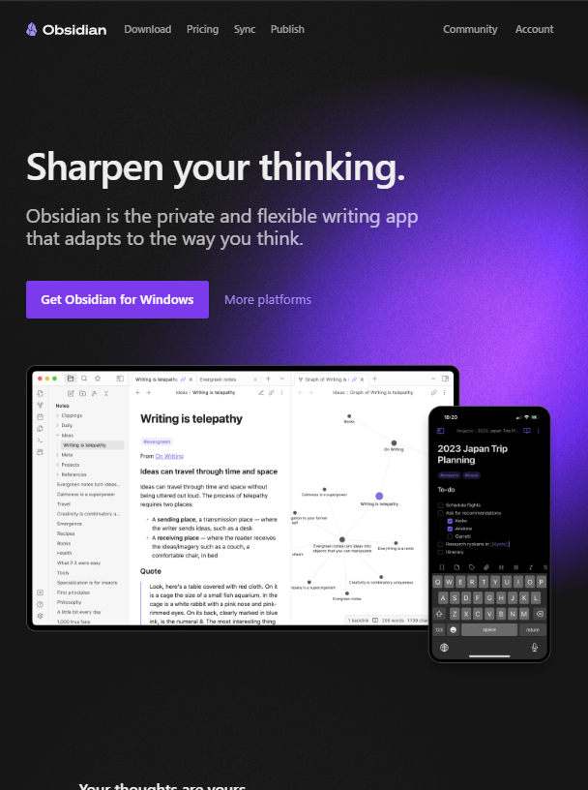
SOLUTION
Obsidian
Note taking Application
Windows
Mac
Linux
Android
iOS
Markdown Format
Synchronization
Themes + Plugins

Slide 9
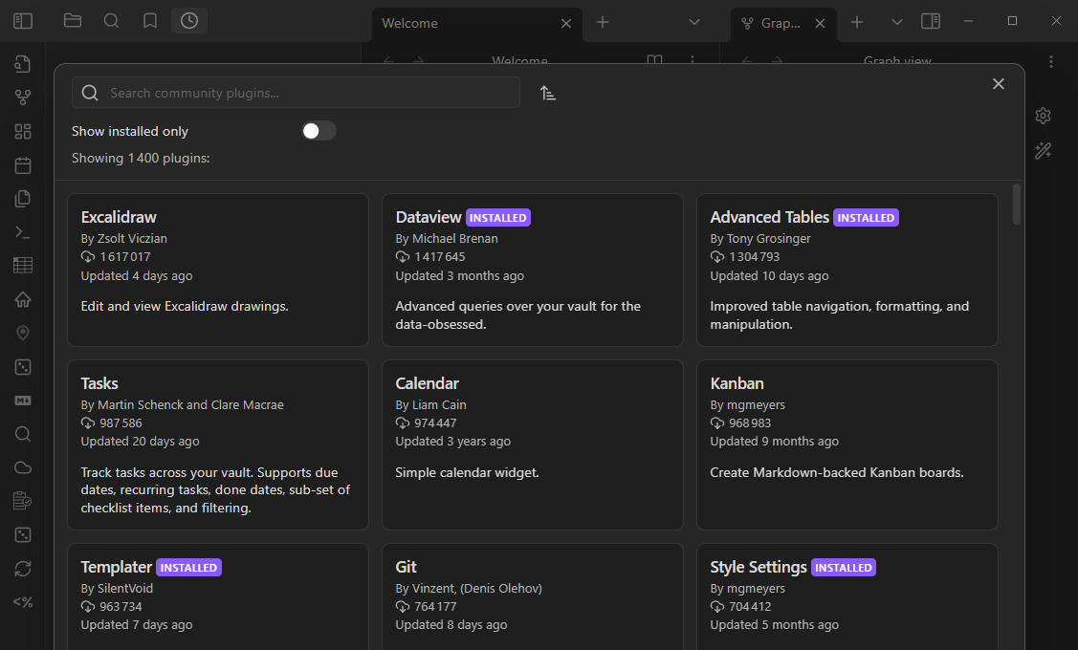

SOLUTION
Personnalization
43 Plugins + 1 Thzme
Admonition
Advanced Paste
Advanced Tables
Auto Link Title
Better Word Count
Charts
Code Block Enhancer
Commander
Convert url to preview (iframe)
Dataview
Duplicate Line
Editor Syntax Highlight
Emoji Shortcodes
Emoji Toolbar
File Color
Format code
Highlightr
Homepage
Iconize
Journey
Linter
Local Images Plus
Markdown Formatting Assistant
Media Extended
MetaEdit
Note Refactor
Omnisearch
Plugin Update Tracker
Raindrop Highlights
Reading Time
ReadItLater
Recent Files
Regex Pipeline
Settings Search
Simple RSS
Style Settings
Supercharged Links
Table of Contents
Tag Wrangler
Templater
Tracker
Various Complements
YTranscript
Thème: Clair de Lune

Slide 10
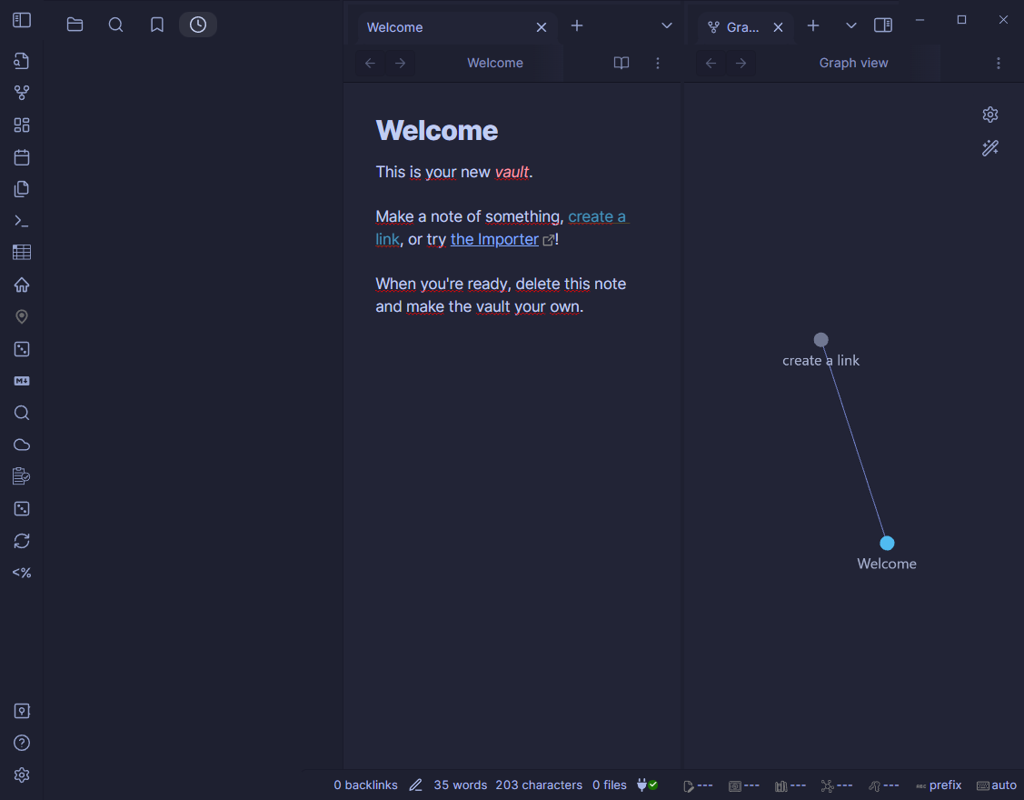
SOLUTION
Esthetics
BEFORE
AFTER

Slide 11
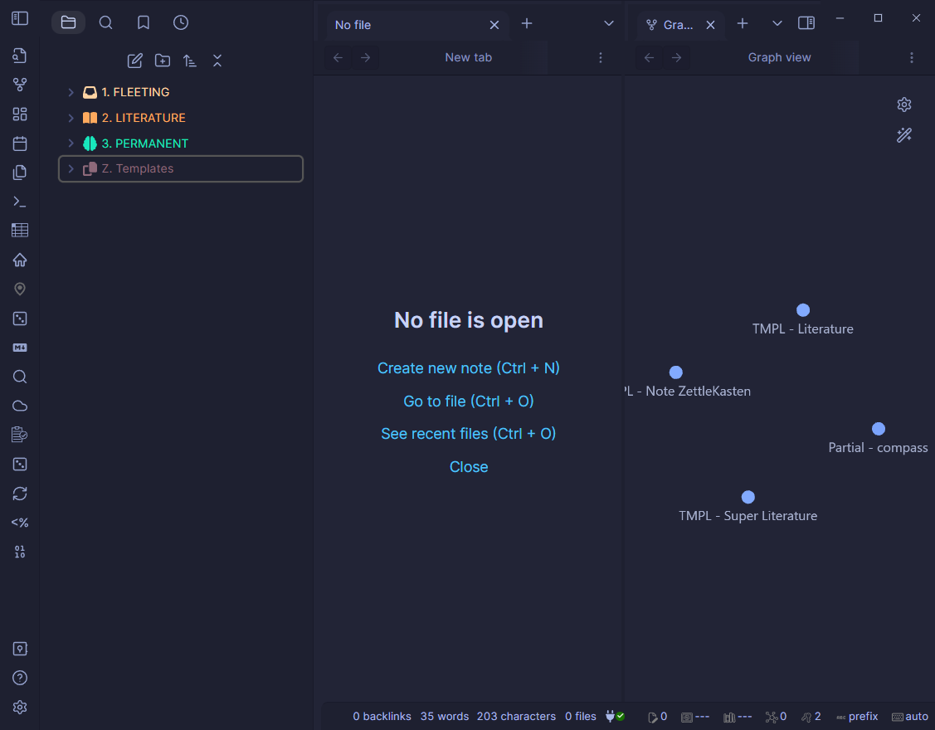

IMPLEMENTATION
Notes Boxes
3 Types of notes
- Fleeting / Literature / Permanent
Color + Icon
Templates

Slide 12
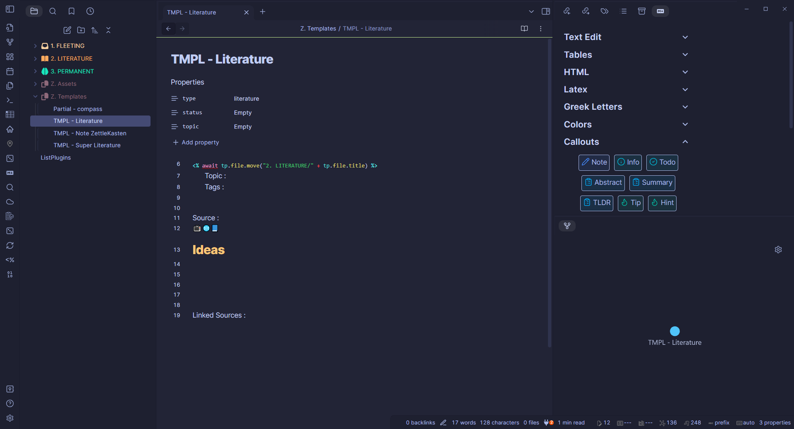
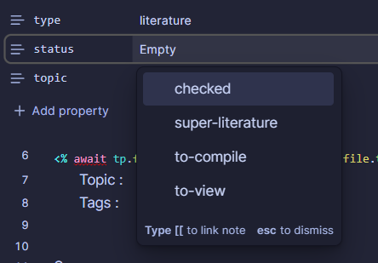
IMPLEMENTATION
Template - Literature
Automate sorting
Status

Slide 13
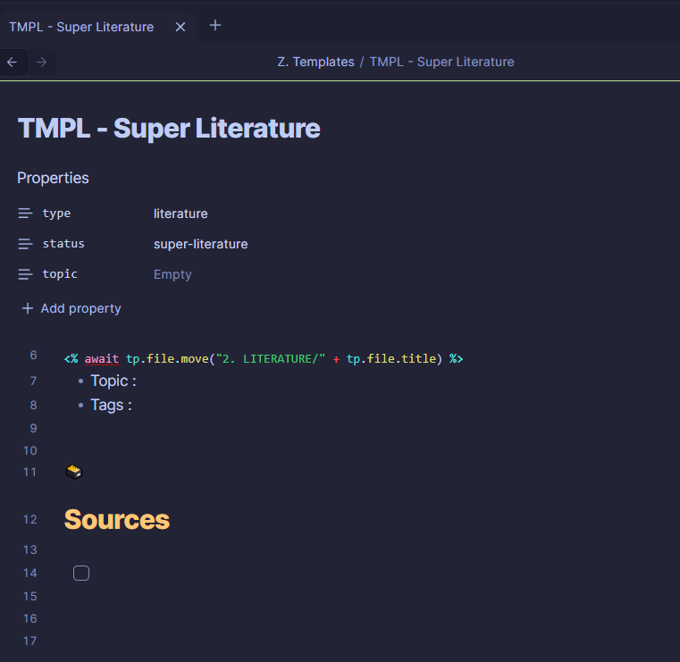
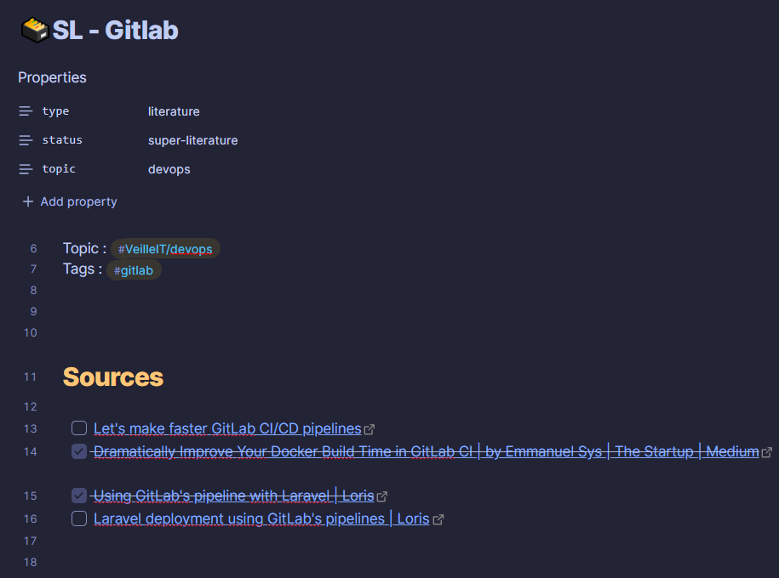
IMPLEMENTATION
Template – Super Literature
Automate sorting
Multiple Sources

Slide 14
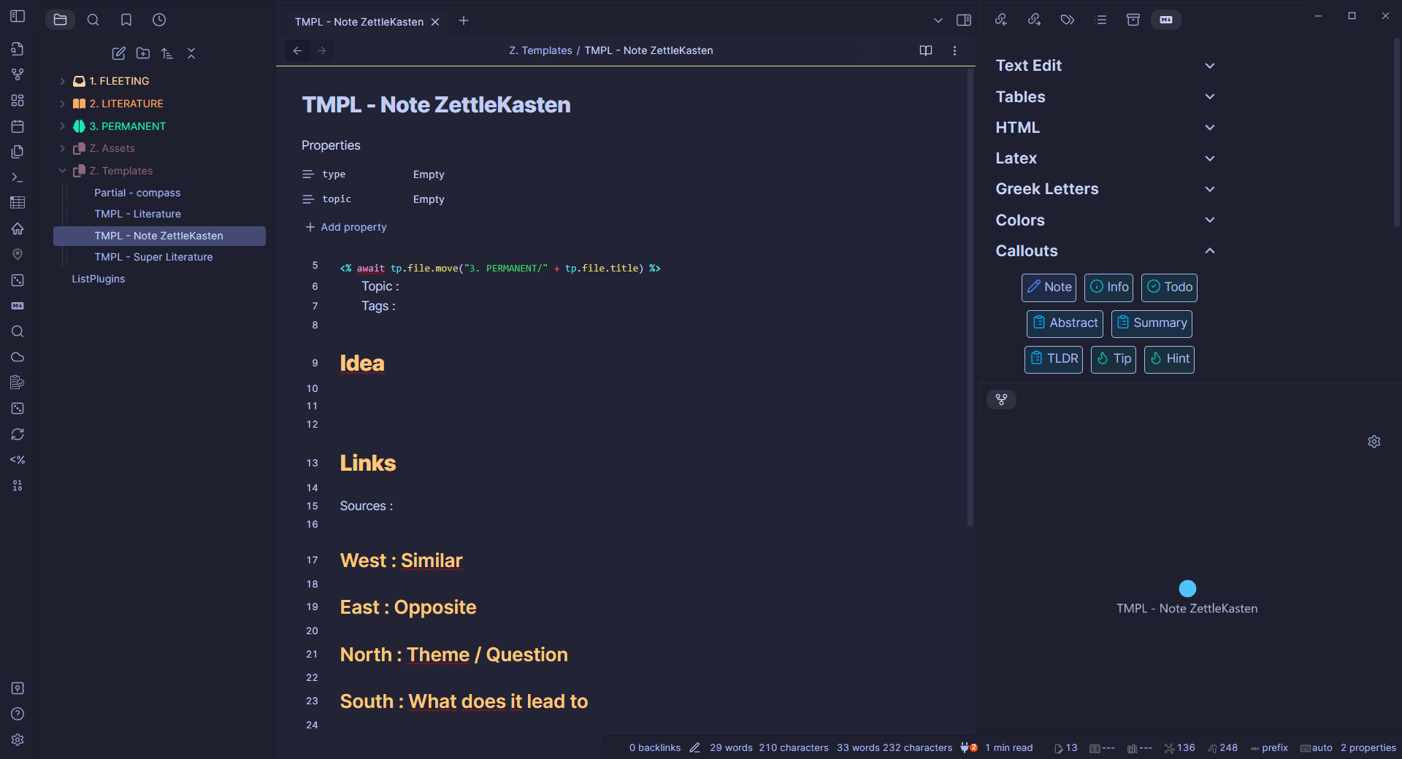
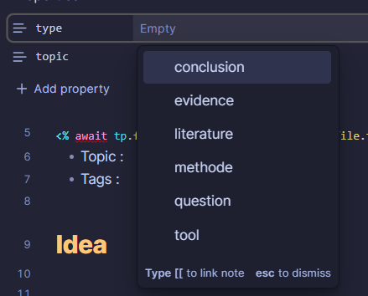
IMPLEMENTATION
Template – Note Zettlekasten
Automate sorting
Types

Slide 15

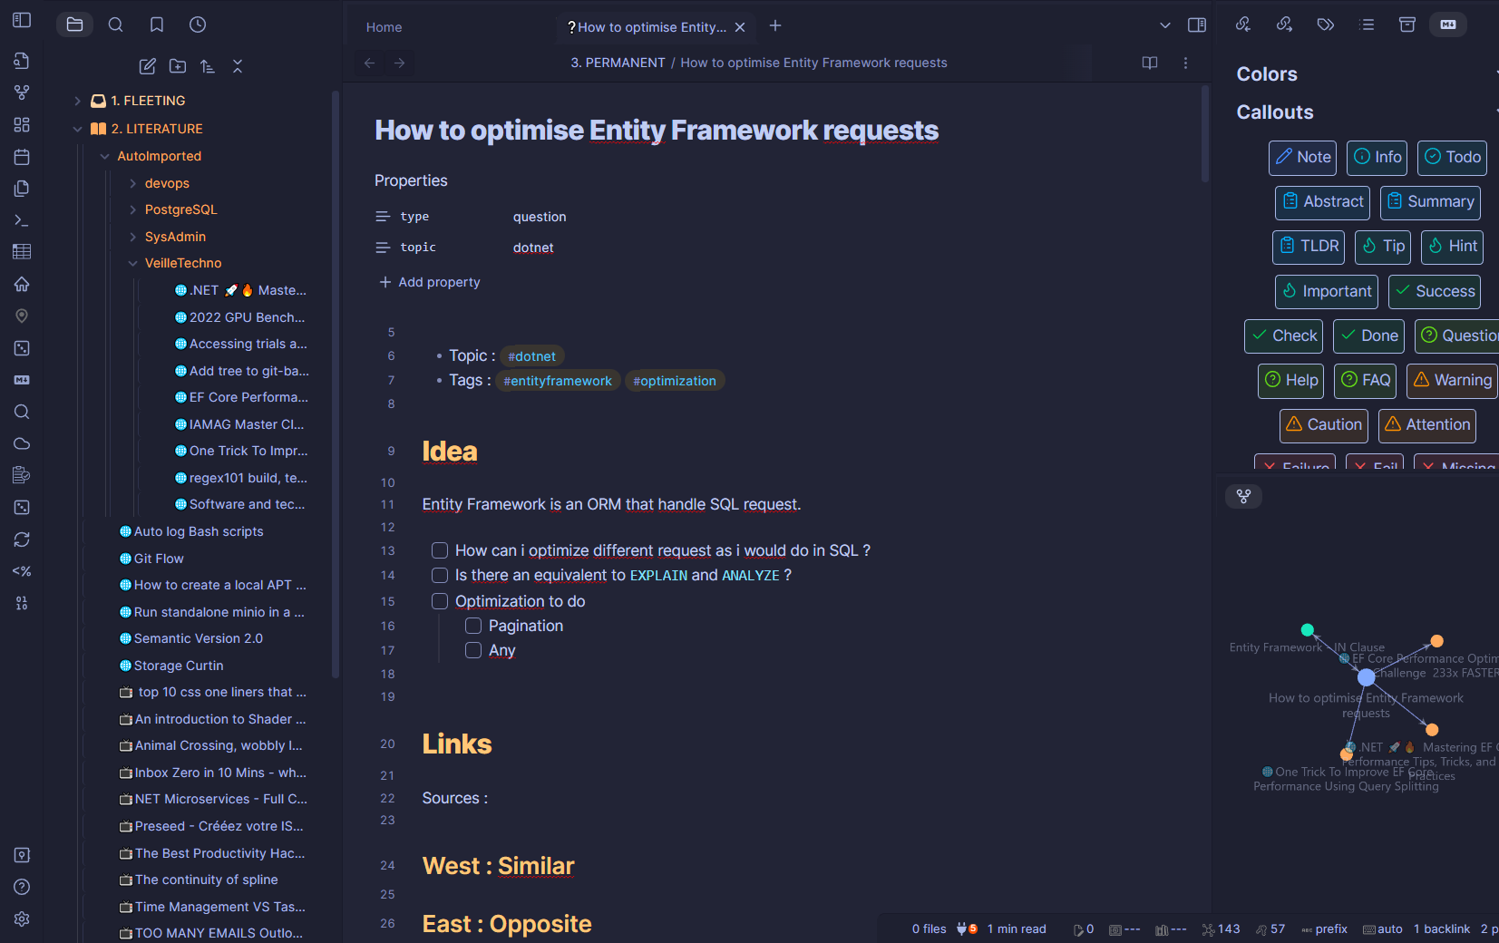
RESULT
Simple Question
Connection Graph
Callouts to higlight

Slide 16
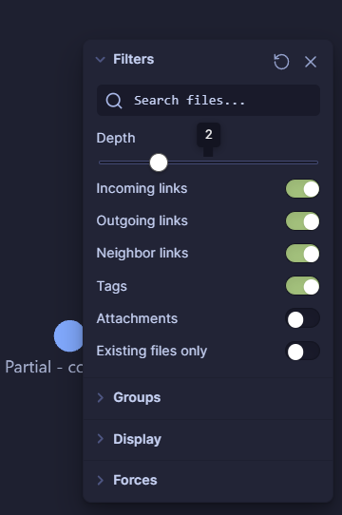
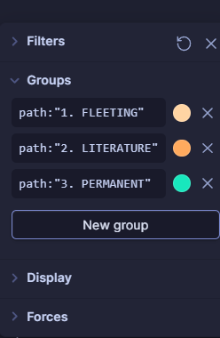
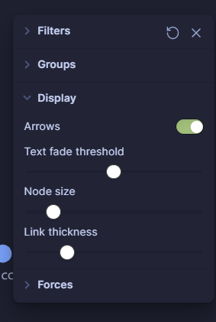
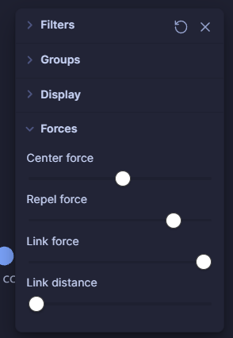
IMPLEMENTATION
Graph des Connexions
View
Colors
Links
Space

Slide 17
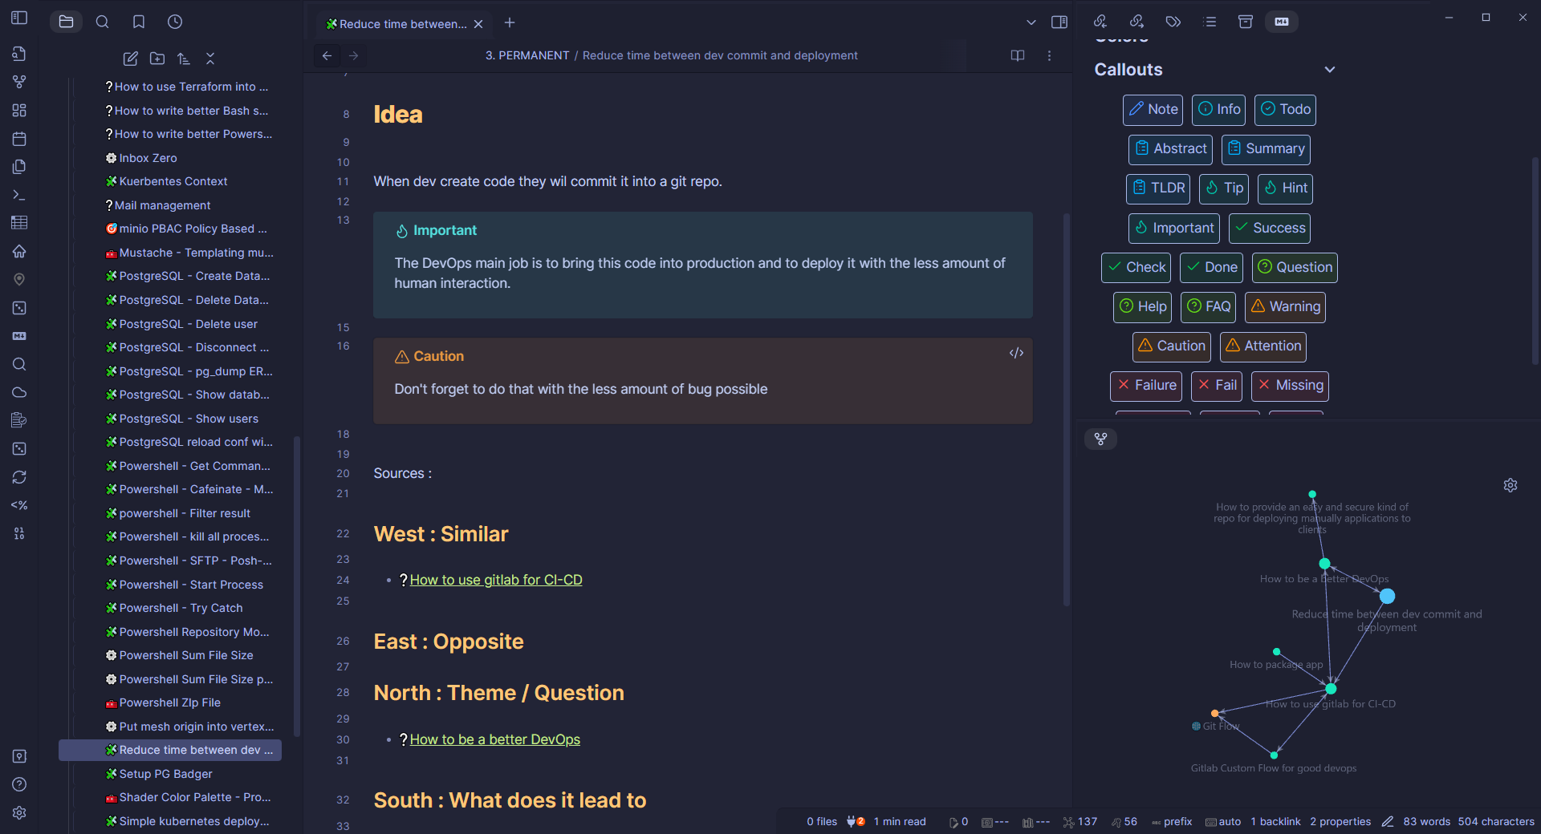
EXAMPLE

Slide 18




PRATICE
YOUR TURN
https://github.com/monnierant/zettlekasten-demo

Slide 19




CONCLUSION
QUESTIONS ?
Scan Me
https://github.com/monnierant/zettlekasten-demo

Slide 20


END
THANKS FOR YOUR TIME
Antoine Monnier

